Slide 1
Formatting a Thesis or Dissertation
Karen L. Greene, PhD
Director, Graduate Admissions & Student Service
Spring 2021

Slide 2
Guidelines
Before anything else, prepare...
Guidelines
MicroSoft Word Template
Formatting and Writing Tips
Delaying Your Publication
And More
https://www.uakron.edu/graduate/current-students/thesis-dissertation
Questions: please reach out to me greene@uakron.edu

Slide 3
Why Formatting
  High standards of presentation
  Standards are applied consistently to all departments and programs
  Precise and complete presentation
  Future publications

Slide 4
Page Format / Margins
Correct margins are:
  Left side 1.5”
    no exceptions
  Right side 1.0”
    no exceptions
  Top 1.0”
    exception: pages that carry major headings, such as preliminary pages and chapter titles, must have a 2.0” top margin
  Bottom 1.0”
    exception: when the last page of a chapter
Figures and tables must fit within the margins

Slide 5
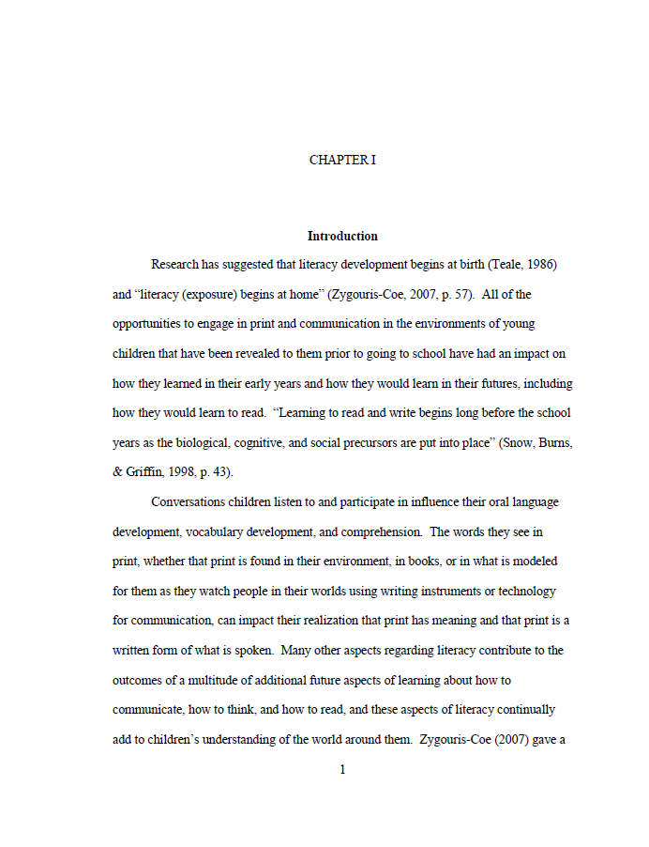
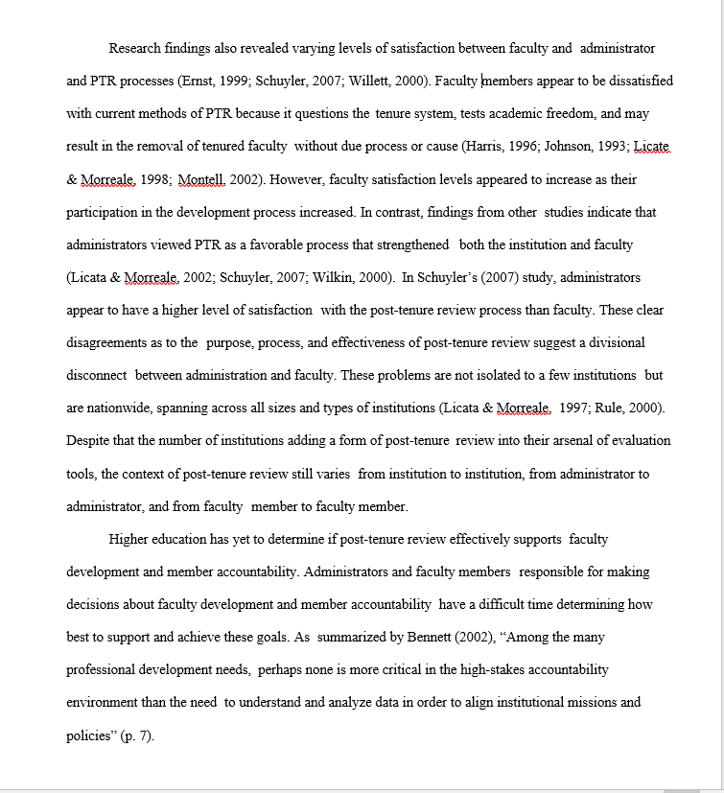
2” top margin
1.5” left margin
1” right margin
Incorrect
Notes:
This first page is an example of a page that is formatting correctly. The top margin for a header page is 2”, the left margin is at 1.5”, the right margin is 1”, and the page number is correctly positioned at the bottom (centered with a 1” margin).
On the next example, you can see this page does not follow the guidelines. Notice the margins are about ½” and no page number.

Slide 6
Widow/Orphan Protection
Pages should be spaced so that no page ends or begins with a single line of text.
At least two lines of a paragraph must appear together at the top & bottom of every page
Notes:
Widow/orphan control improves the layout by keeping a more balanced amount of content flowing from page to page as the viewer reads your document from start to finish.
If you do not use the available template, you can set Word to address widow/orphans.

Slide 7
Spacing
Text material is double spaced throughout.
Do not insert extra blank lines or spacing to separate text.
Single spacing may be used in:
  figure captions
  table titles
  long quotations (properly indented)
  notes
  bibliography/references section
Notes:
Do not “fill-up space” with extra or blank lines.
Avoid excessive white or blank space.
You should never have more than 2 blank lines or gaps of white space anywhere in your document. This means you may need to resize your figures or tables.

Slide 8
Typeface, Justification, Centering & Paragraphing
Fonts
  MUST be consistent throughout the manuscript
  Font size must the same size throughout (12 point preferred)
  Most fonts are acceptable, however San Serif is preferred
  Unusual or scripted fonts are not acceptable
  Do not use bold font for major titles or figure/table titles
The left margin must be justified
Right margins may be justified if the department/college approves
  Note: full-justified margins may result in unsightly white spaces between words that are not acceptable.
Indent the first line of every paragraph consistently (5 spaces preferred)

Slide 9
Page Numbering
Preliminary pages are in Roman numerals (i, ii, iii)
  Title page is page i.
    It is counted but not numbered on the actual page.
  The signature page is page ii.
    It is counted and numbered on the page.
Text pages (beginning with CHAPTER I) are in Arabic numerals (1, 2, 3, etc.)
  Beginning with page 1 of CHAPTER I, all following pages are numbered sequentially through the end of the manuscript.
Notes:
Preliminary pages, or front matter, consists of title page, signature page, abstract, acknowledgement, dedication, any “list” pages, and the table of contents, and your list pages if applicable.

Slide 10
Page Numbering (con’t)
Copyright page (optional page)
  is placed as the very first page (before the title page)
  is neither counted nor numbered
Page number embellishments are not permitted (1a, 1b, etc.)
All pages have the page number placed at the bottom of the page, centered under the text at the 1 inch bottom margin.
Notes:
In the United States today, copyright protection automatically covers all new copyrightable works, including your dissertation. The moment a copyrightable work is fixed in a tangible medium of expression (e.g., written on a piece of paper or on your hard drive), it is subject to copyright.
In the past, authors had to comply with certain formalities in order to obtain copyright protection. These formalities included registering the work with the US Copyright Office and placing a copyright notice on the work. Copyright law no longer requires that authors comply with these formalities merely to obtain copyright protection.

Slide 11
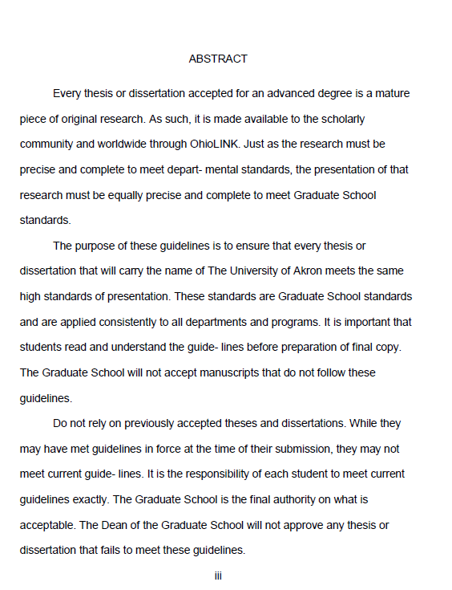
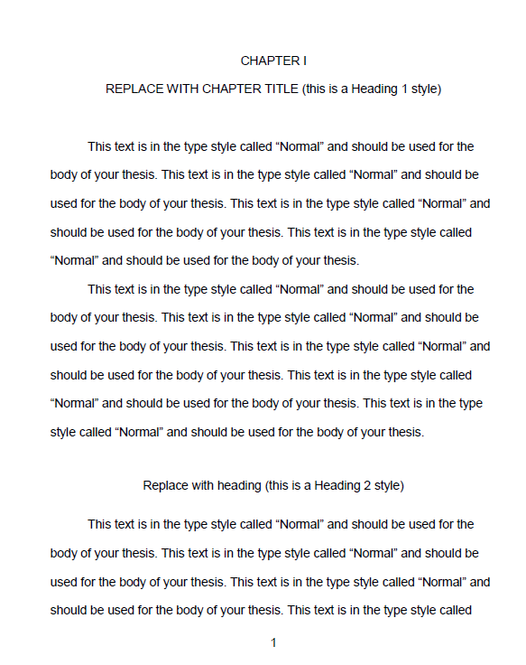

Notes:
Here are example of correct page numbering (please note that the margins not to scale)

Slide 12
Manuscript Organization
Copyright Notice (optional) (not counted or numbered)
Title Page (counted, not numbered)
Signature Page (page ii)
Abstract
Dedication (optional)
Acknowledgements (optional)
Table of Contents
List of Tables (as needed)
List of Figures (as needed)
List of Illustrations (as needed)
List of Schemes (as needed)
Chapters (begin Arabic page numbering, I, II, III, IV, V)
Bibliography
Appendices
Notes:
Every thesis or dissertation follow a general organization or layout.
Copyright protection automatically exists from the time you place your thesis or dissertation in fixed form. There is no requirement to obtain protection under copyright law. Adding this is optional.
Preliminary Pages – all pages before the start of Chapter I.
Standard organization of a manuscript consists of five chapters.
Chapter I: Introduction
Chapter II: Literature Review
Chapter III: Research Methods
Chapter IV: Research Results and Discussion
Chapter V: Conclusion and Future Work
Bibliography or References
Appendices (including Human Subjects Approval and/or other approvals as required)

Slide 13
Title Page
All text on this page is centered
Double space the entire page
The top margin is two-inches (2”)
Title
  Must be in all capital letters
  Must be centered immediately below the two-inch top margin
Graduation date
  Must be month, year of graduation (May, August or December only)
Title page is counted as page i
  However, this page number is not shown

Slide 14
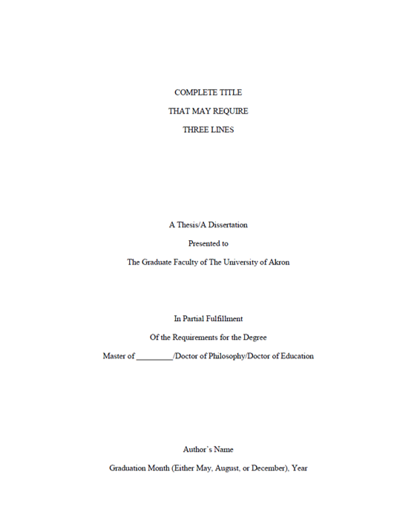
Title Page
Notes:
Example

Slide 15
Signature Page
Title
  All capital letters
  Centered immediately below the two-inch top margin
  Double spaced if two or more lines
Author’s name
  Case sensitive (not all caps).
Signature page is counted as page ii
The names of those signing are typed a single space below their titles
Use “Dr.”, “Mr.”, “Mrs.”, before all names

Slide 16
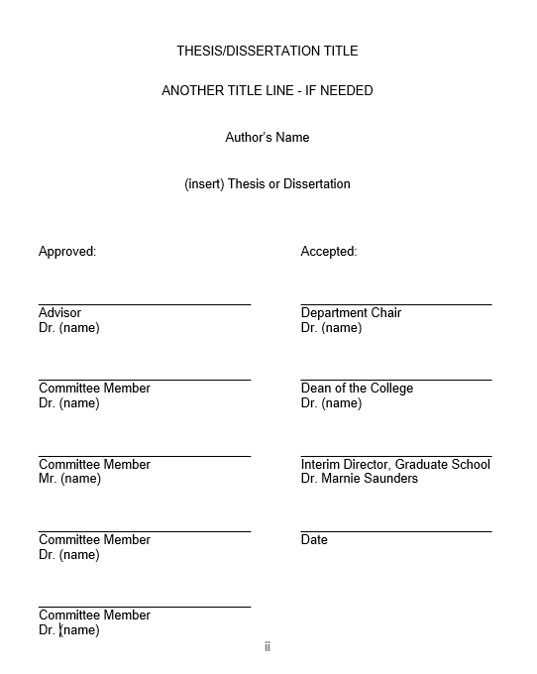
Signature Page
Notes:
Example (not to scale)

Slide 17
Table of Contents (TOC)
All entries in the Table of Contents must match exactly as they appear in the text including: wording, numbering, punctuation, capitalization and spelling and page number on which they appear
Preliminary pages that occur before the TOC are not included
Preliminary pages that occur after the TOC are included (e.g., List...)
Include the word “CHAPTER” after the last preliminary listing(s) and above the first chapter listing
Chapter titles are typed in all capital letters and use Roman numbers
  Subheadings are case-specific
Double Space between entries
Single space within an entry if it falls on two or more lines
Notes:
Table of Contents – the majority of formatting errors occur here.

Slide 18
Table of Contents (cont’d)
Chapter numbers
  Roman numerals (I, II, III, IV, V)
  Left-aligned
Indenting should be consistent basis
If there is only one appendix, label it as APPENDIX.
If there are multiple appendices, label it as APPENDICES
Appendices should be labeled as APPENDIX A, APPENDIX B, etc. including titles in all caps.

Slide 19
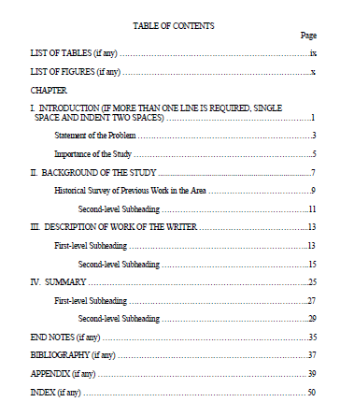
Notes:
Note – this examples are not to scale but shows you one example of a Table of Contents correctly formatted.
The next page shows another example of how you can format using numbering.
Either TOC is fine

Slide 20
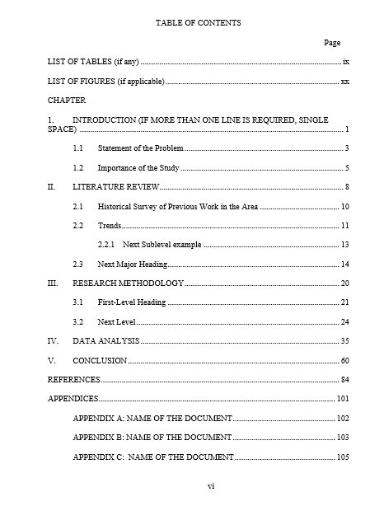
Notes:
Another example of a TOC formatted using a numbering system.
Notice the Roman numerals for the Chapter name, but Arabic numerals for the level headings

Slide 21
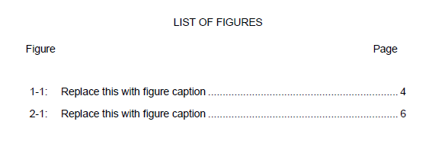
TOC: List of Tables and List of Figures
“Figure,” “Table, ” or the appropriate heading is typed above the number designation column (left).
Type “Page” (right)
Do not type “heading label” before every entry
Notes:
Do not type Figure 1.2, Figure 2.1, or Table 1.2, Table 1.3, etc on the actual list.

Slide 22
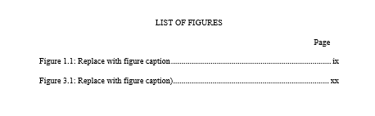

TOC: List of ...
Notes:
For your “List” pages –
DO NOT include the following descriptors – only the number
Figure
Table
Scheme
Illustration

Slide 23
TOC: List of Tables and List of Figures
All entries in List of Tables, List of Figures, etc must match exactly as they appear in the text, including -- wording, numbering, punctuation, capitalization and spelling and page number on which the table/figure appears.
Exception – if the description is too long, you may opt to include only the first full sentence of the description.

Slide 24
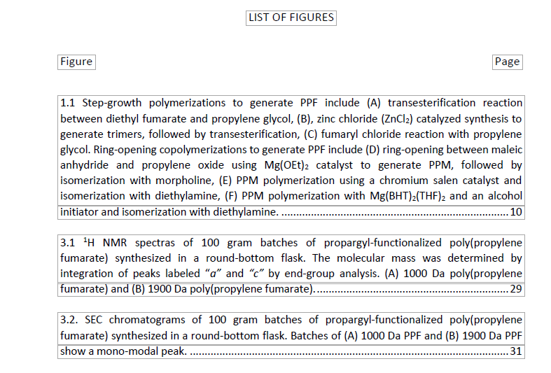
TOC: List of Tables and List of Figures
Notes:
Note – this is showing how to format only; not to scale.
This example shows the single space caption of a figures, but double space between each item.

Slide 25
TOC: List of Tables and List of Figures
Do not use combinations of letters and number for your table/figure designations.
    Example: If working in Chapter 4
      Do Use: 4.2, 4.3, 4.4
      Do Not Use: 4A, 4B, 4C

Slide 26
Tables / Figure with the Text
Table titles appear above the table
Figure/Scheme titles are to be placed below the figure/scheme
Do not bold any part of the title/figure text
Each title must be numbered consecutively in Arabic numbers
Landscaped entries are acceptable

Slide 27
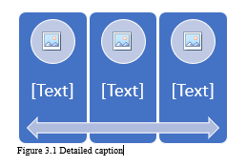
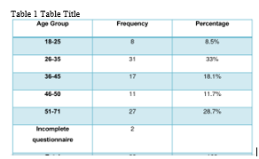
Tables / Figure with the Text
Notes:
Here you can see the placement of the figure and table titles or descriptions. Tables are placed above the table. All others (figures, schemes, graphs) are placed below the item.

Slide 28
Body of the Manuscript / Text
This begins the Arabic numbering (1, 2, 3)
The text begins with Page 1 of CHAPTER I
Page numbers are centered at the 1” bottom margin
All text is double spaced throughout
At least two lines of text must appear at the top and bottom of each page
  Remember: No widows/orphans

Slide 29
Body of the Manuscript / Text
All subheadings must be followed by at least two lines of text
Page margins
  1” for top
  except: top margin on “header” pages (2”)
  1.5” left
  1” right
  1” bottom

Slide 30
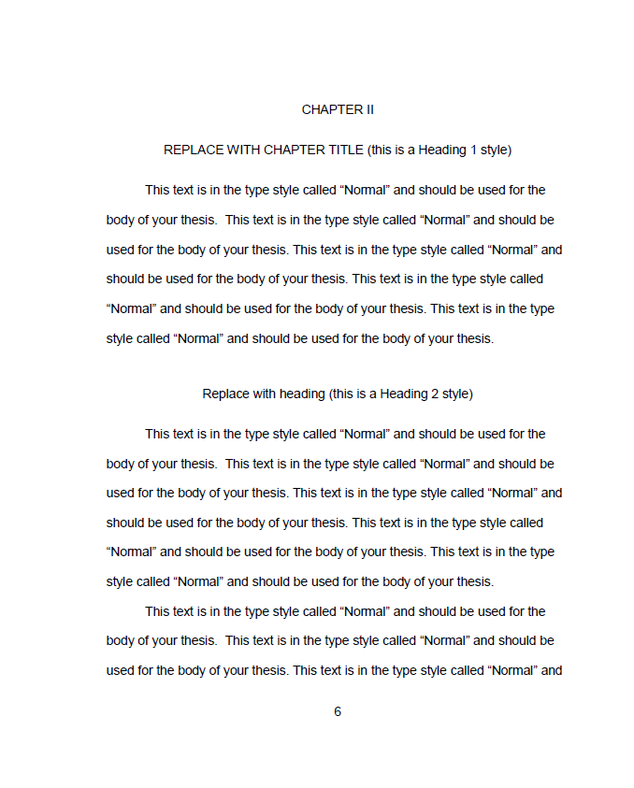
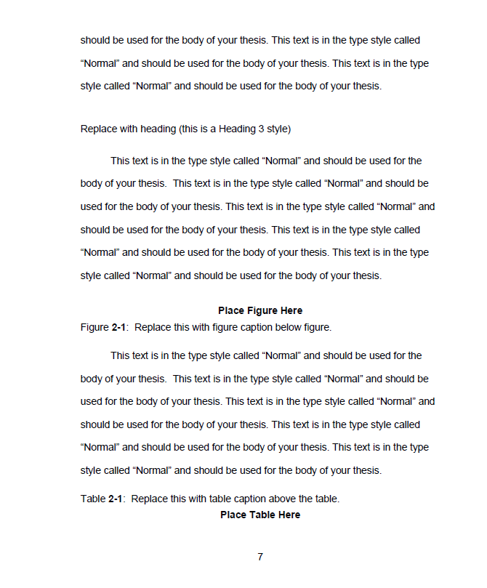
Notes:
Example of proper formatting You can see we start a chapter with 2” top margin. You can also see the spacing between headings and subheadings.
The bold text is only for emphasis on show a figure or tables being pasted

Slide 31
Chapter Title Pages
A chapter title page is the start of a new chapter.
All chapter title pages have a 2” top margin
All chapters start with its own separate page
CHAPTER I, II, III, etc. is typed in all capital letters without punctuation, centered between the margins

Slide 32
Chapter Title Pages (cont’d)
The chapter title is typed in all capital letters two spaces below the heading, centered between the margins
  Should the title be more than one line, it will be double spaced
Text of the chapter begins three spaces below the chapter title
If a subheading follows a chapter title, it is placed three spaces below the chapter title
  Text is then two spaces below the subheading

Slide 33
Chapter Title Page
Notes:
Example Not to scale here, but to show you spacing.
Notice the ALL CAPS chapter and roman numeral
The chapter title should be ALL CAPS centered

Slide 34
Bibliography, References or Literature Cited
REFERENCES or BIBLIOGRAPHY - all caps & centered
2” top margin
Lists ALL sources used in your work
Page numbering continues in Arabic numerals
Single space within entries with double space between entries
Notes:
Bibliography
Refers to all sources read for research, including material not cited
References
Refers only to those sources cited in the manuscript
Contact your advisor / academic department to see which you should use
More than one can be used
Bibliography would appear first, then References or Literature Cited

Slide 35
Appendices
The material must be set up like a new section
If there is only one appendix
  APPENDIX centered below the 2” top margin
  Text/material to follow three spaces below
If there are two or more appendices
  A division page is inserted before Appendix A
    The word APPENDICES will be centered between the margins, slightly above the center of the page
    Page number placement continues as in text
    This page will appear in the TOC as well
  Each appendix should be treated as a separate section with its own page
  Labeled Appendix A, Appendix B, etc.
    Be sure to add the individual appendix titles in the TOC .

Slide 36

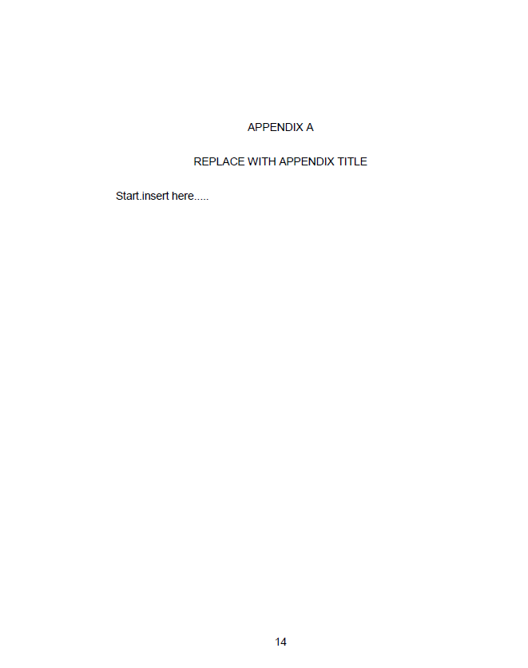
Notes:
In this example – if you have multiple appendices you would add the introductory APPENDICES page and then follow the same formatting.
If you DO NOT have more than one Appendix – do not include introductory APPENDICES page.

Slide 37

Format Checking
If at any time you have questions, please contact me.
greene@uakron.edu
330-972-2135
Notes:
We’re almost done. I’m going to share a few more things to keep in the back of your mind.

Slide 38

Electronic Submission Procedures
      Uploading your ETD to OhioLink
        https://etdadmin.ohiolink.edu
The document you upload to OhioLINK must be your final thesis or dissertation.
This means it has been successfully defended with all corrections made.
Notes:
Directions on how to upload to OhioLink can be found on the Graduate School website.
Remember = There are deadline dates.
When uploading your manuscript to OhioLINK – please keep in mind that if you use OhioLink as a Sandbox with your committee, when you’re ready to submit you need to update all the information on the screens prior to uploading. Often students forget to go back and enter the year and page number totals. You also need to enter the final committee list on the appropriate page.
Do not enter Dr. in the Suffix. Dr. is not a suffix. You can enter PhD or leave it blank.

Slide 39

Electronic Submission Procedures
Paper Information Tab
  Last, First, Middle
  Title
  Abstract
  Keywords
  Subject Headings (related disciplines)
  Year Completed
  Pages
Notes:
Directions on how to upload to OhioLink can be found on the Graduate School website.
Remember = There are deadline dates.
When uploading your manuscript to OhioLINK – please keep in mind that if you use OhioLink as a Sandbox with your committee, when you’re ready to submit you need to update all the information on the screens prior to uploading. Often students forget to go back and enter the year and page number totals. You also need to enter the final committee list on the appropriate page.
Do not enter Dr. in the Suffix. Dr. is not a suffix. You can enter PhD or leave it blank.

Slide 40

Electronic Submission Procedures
Degree Information Tab
  Degree
  College/School/Dept/Program
  Year
  Committee Members
    Last Name First Name Suffix/Deg Role
Notes:
List ALL Committee members – not just your advisor
Do not enter Dr. in the Suffix. Dr. is not a suffix. You can enter PhD or leave it blank.
See Next slide for appropriate Suffix.

Slide 41
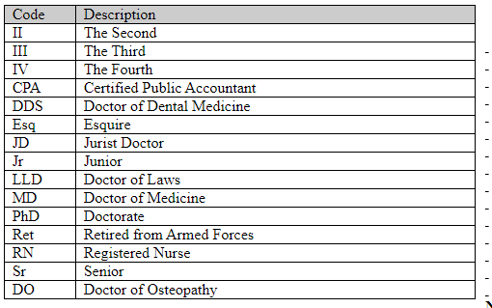
Electronic Submission Procedures
Appropriate Examples of a Suffix
Notes:
List ALL Committee members – not just your advisor
Do not enter Dr. in the Suffix. Dr. is not a suffix. You can enter PhD or leave it blank.

Slide 42

Electronic Submission Procedures
Publication Information Tab
  Copyright
  Delay of Publication
  Reviewer Action (Graduate School can only access this)
  Proquest/UMI
Notes:
See next slide for more information

Slide 43

Delay of Publication
  How To: (2 step process)
  Enter the delay of publication information to OhioLink when you upload your manuscript.
  Complete and return the Delay of Publication Form (https://www.uakron.edu/dotAsset/677911.pdf
  BOTH STEPS ARE REQUIRED: THE GRADUATE SCHOOL IS NOT RESPONSIBLE FOR THE RELEASE OF INFORMATION IF BOTH STEPS ARE NOT FOLLOWED.
This Photo by Unknown Author is licensed under CC BY-SA
Notes:
In some circumstances, a student may wish to delay the electronic publication of a thesis or dissertation.
Talk to your advisor.
For example:
- to publish an article from the thesis or dissertation in a journal whose policy is not to publish anything that has already been published electronically;
- You in the process of applying for a patent on research contained in the thesis or dissertation and does not wish to disclose its contents until the patent application has been filed.
PLEASE COMPLETE BOTH STEPS IN THIS PROCESS. THE GRADUATE SCHOOL IS NOT RESPONSIBLE FOR THE RELEASE IF BOTH STEPS ARE NOT FOLLOWED

Slide 44

Electronic Submission Procedures
Document Upload Tab
  Document Type
  File
Notes:
Your manuscript must be in pdf form.
You may upload supplemental documents (e.g., video) – Rarely used, but available.

Slide 45
Format Checking and OhioLINK
Please note your manuscript will not be visible to the public when you upload it to OhioLink. It will only be visible to me.
Your manuscript will be released for public view after your degree has been conferred by the University Registrar. Exception: When a delay of publication has been submitted

Slide 46

Important Dates
Notes:
It is important for you to PLAN AHEAD. The deadlines are posted on our website.
I recommend that you work with your advisor in advance to schedule your defense at the start of the semester so you can graduate on-time. Work and plan backwards from that date.
DO NOT WAIT to the last minute. We do not grant extensions. If you fail to meet the deadline, your graduation will be deferred to the next term.

Slide 47
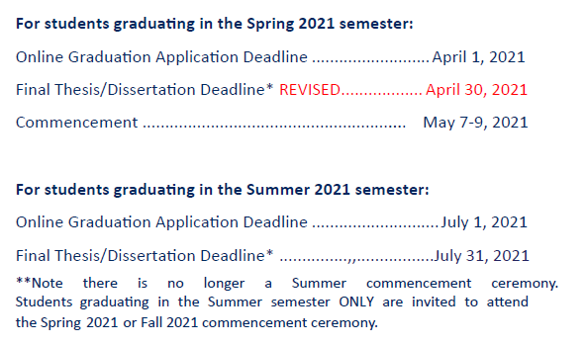
Deadline Dates
https://www.uakron.edu/gradsch/docs/deadlines.pdf

Slide 48
Questions and Contact Information
Karen L. Greene, PhD
Director, Graduate School & Student Services
Graduate School | Leigh Hall 515
greene@uakron.edu
330-972-2135
Notes:
I know this was a quick review and there is a lot of information to absorb.
So please contact me if you have questions about formatting, Ohio Link and/or graduation!
Thank you and Good luck.

